Slide 1
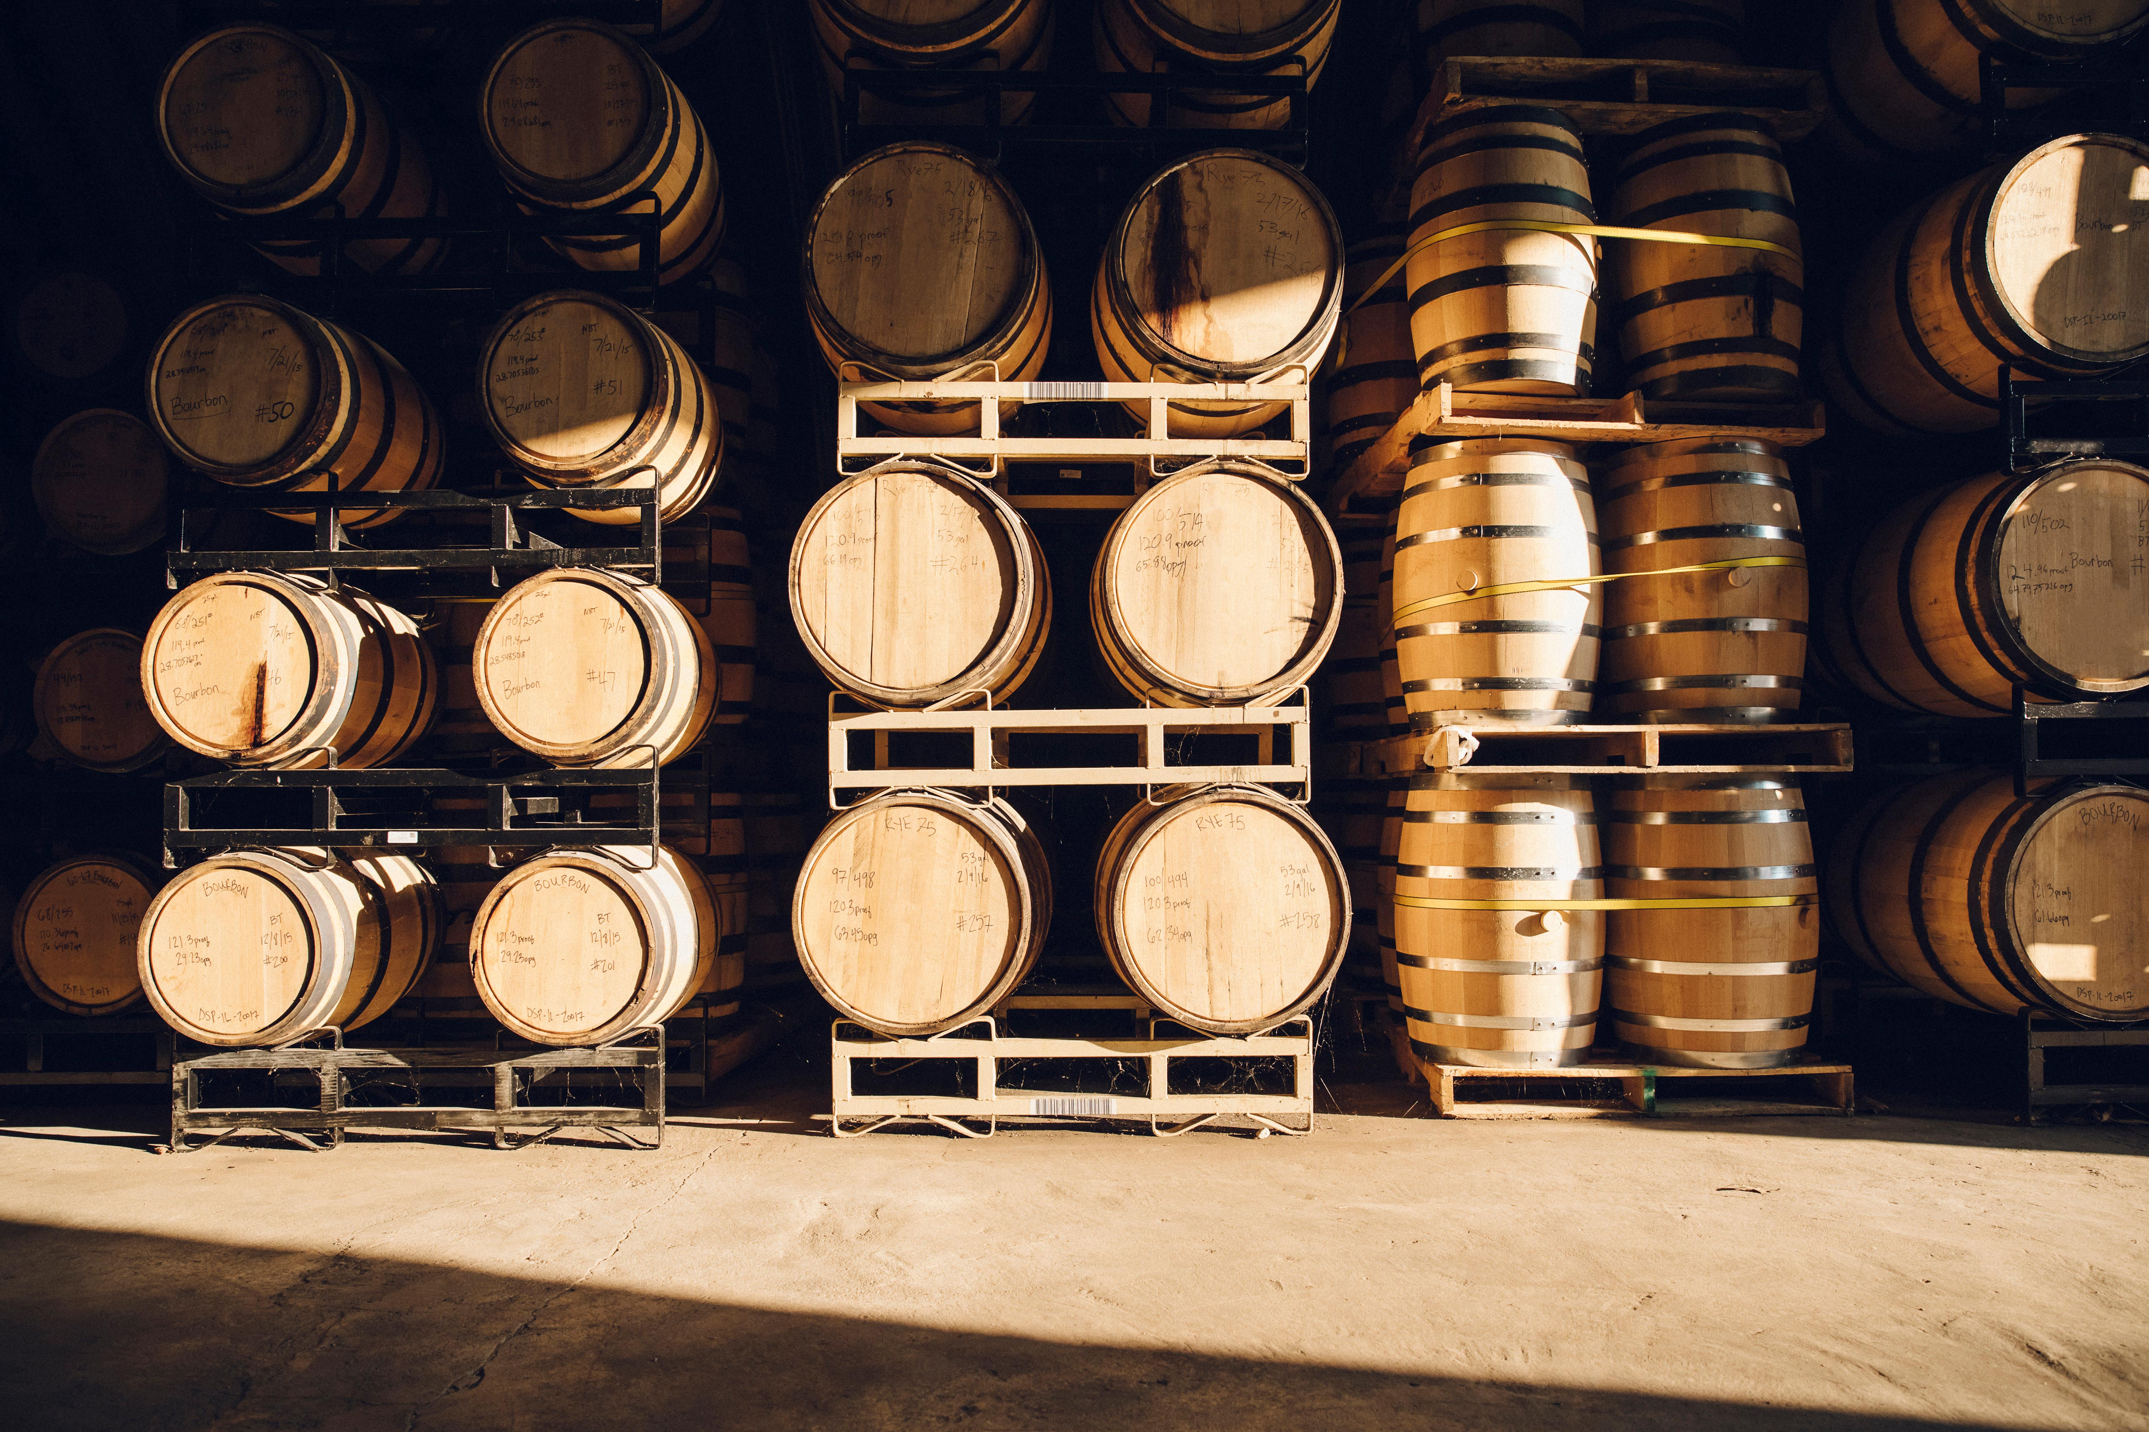
Wine quality prediction model Brianna Beyer | Denis Dragan | Summer Dowdy | Jason Hinshaw

Slide 2
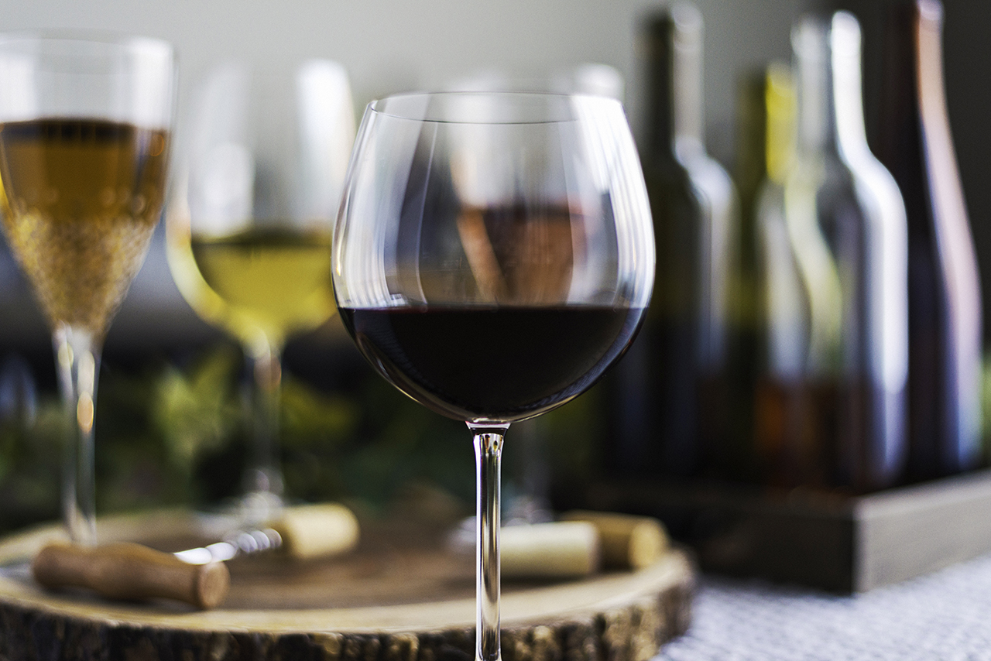
overview
Why we chose wine quality
The purpose of this project is to provide accurate wine quality predictions based on physiochemical properties using neural network and random forest models.

Slide 3
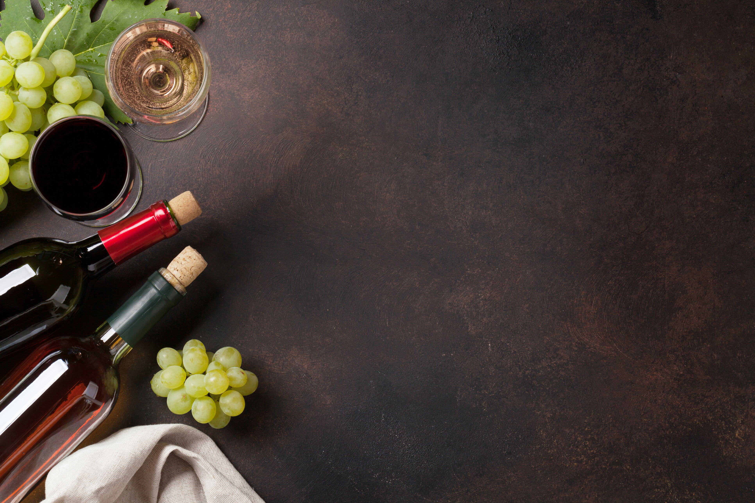
Wine 101
How is wine made?
What are the types of wine?
What are wine varietals?
What is an appellation?
What makes wine good? bad?

Slide 4
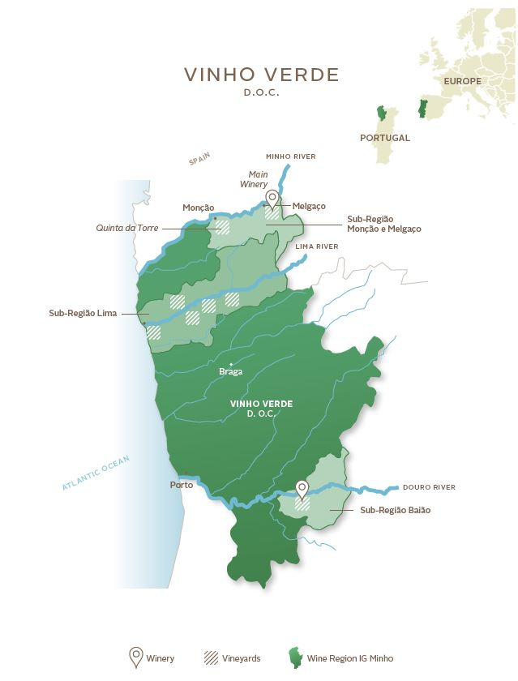
the Datasets
UC Irvine Machine Learning Repository based on data from the 2009 paper, Modeling wine preferences by data mining from physicochemical properties.
2 Datasets: Red Wine & White Wine
1,599 red data points / 4,898 data points
Data collected from Vinho Verde region in the northwest of Portugal
Each wine was analyzed, and quality assessed between 2004 and 2007 by the Viticulture Commission of the Vinho Verde Region.
Variables: 11 physiochemical properties & quality score
UC Irvine Wine Quality Datasets
Modeling Wine Preferences Paper

Slide 5
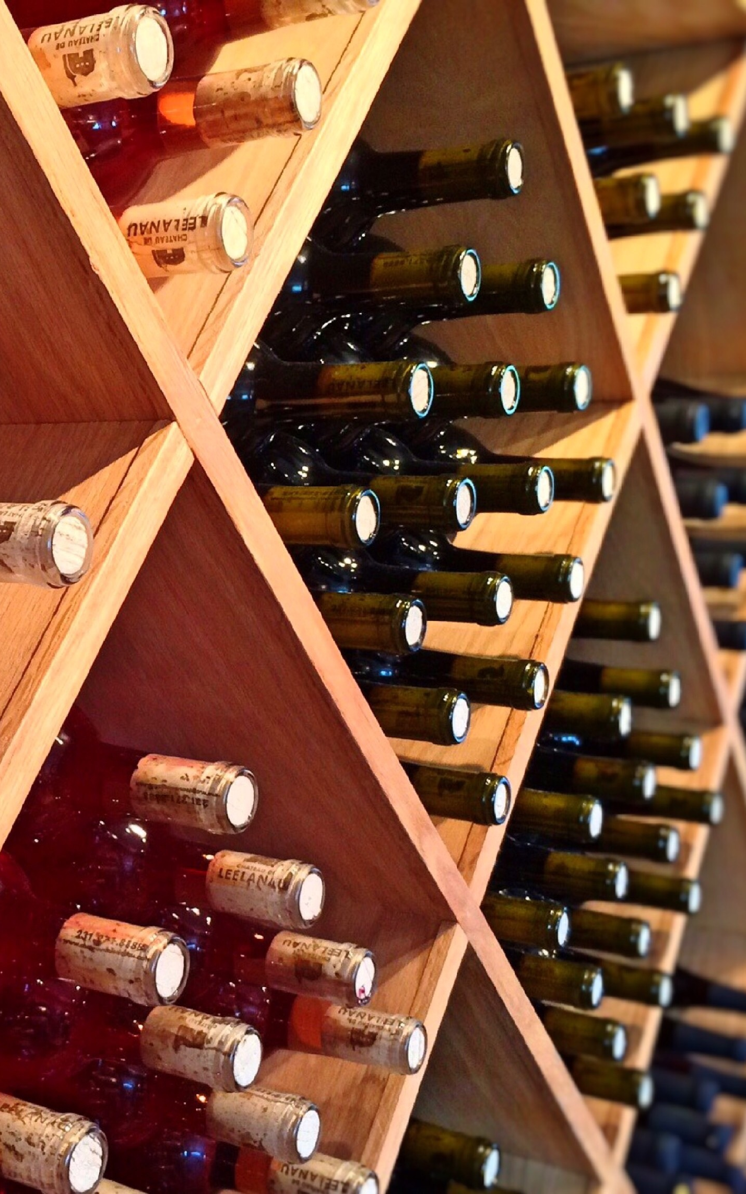
Variables
Fixed Acidity
Volatile Acidity
Citric Acid
Residual Sugar
Chlorides
Free Sulfur Dioxide
Total Sulfur Dioxide
Density
pH
Sulphates
Alcohol
Quality Score between 0 and 10
0 to 3 = Low
4 to 6 = Average
7 to 10 = High

Slide 6
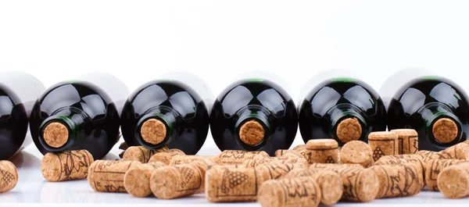
Neural Network model
Why we chose this model

Slide 7
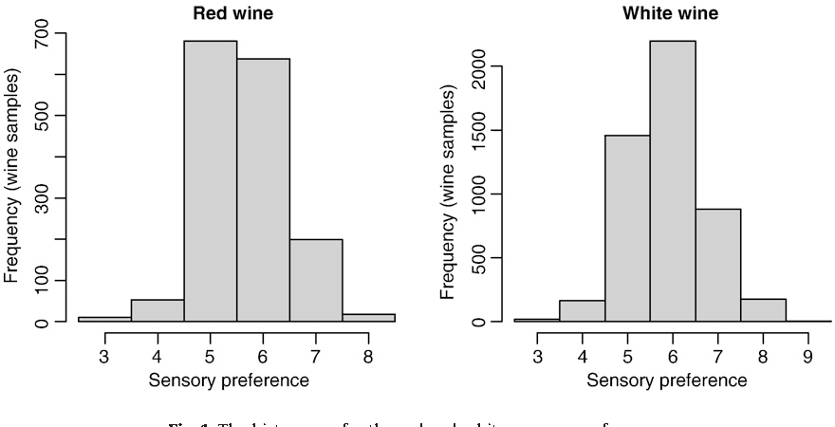
Quality Distribution

Slide 8
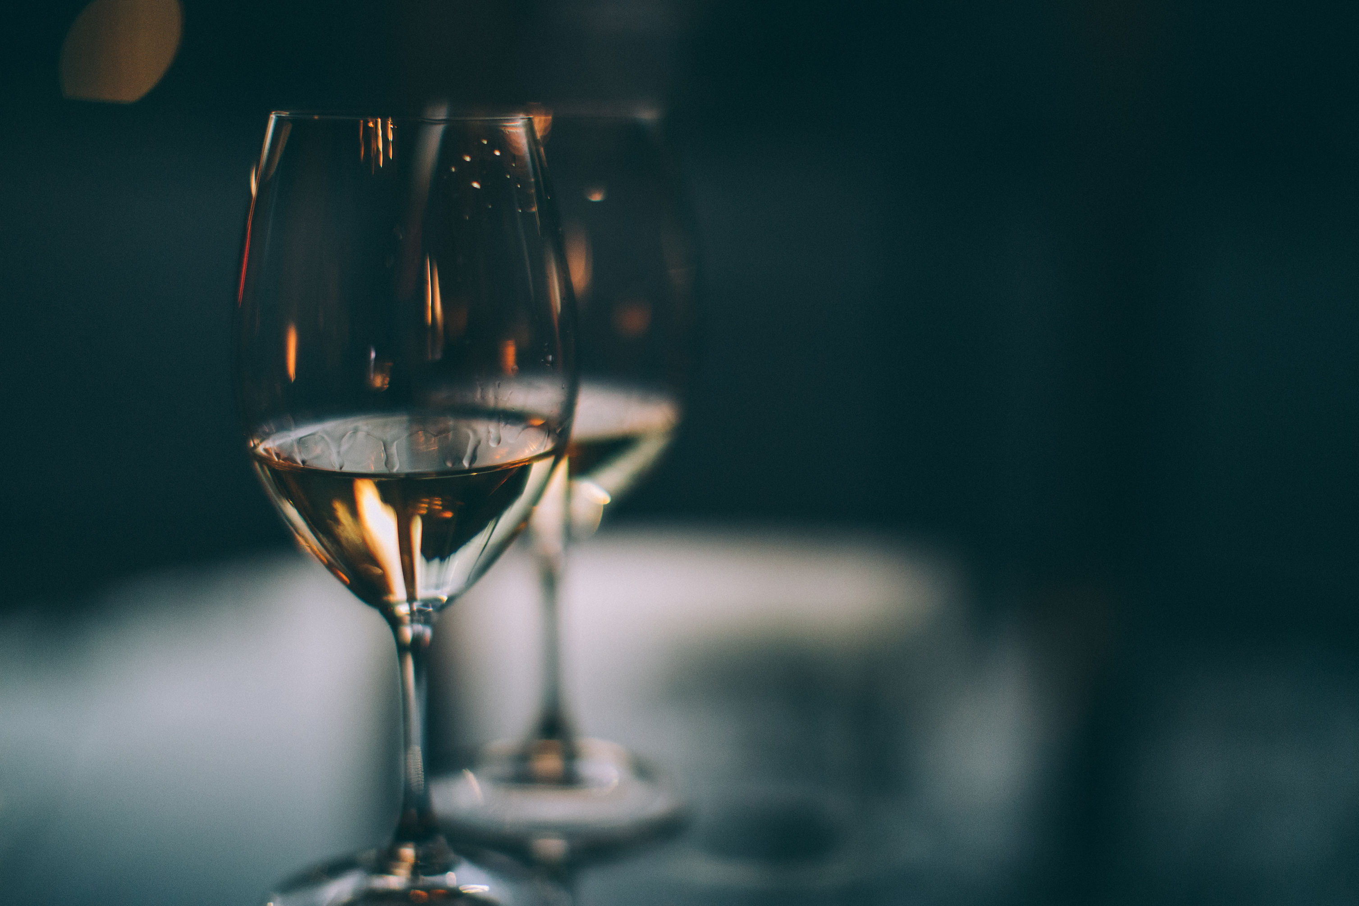
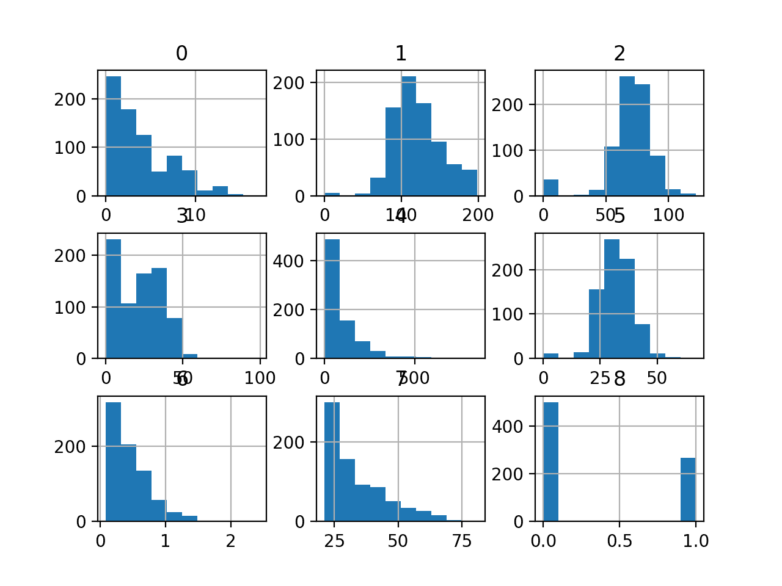
Scaled variables

Slide 9
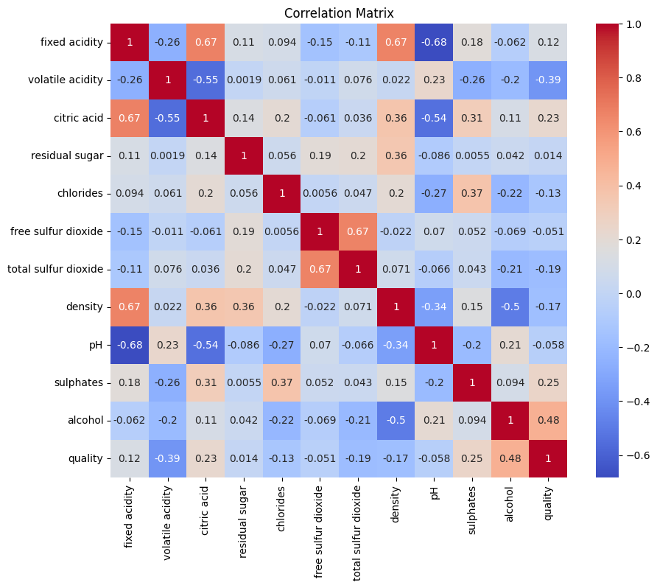
Correlation matrix

Slide 10
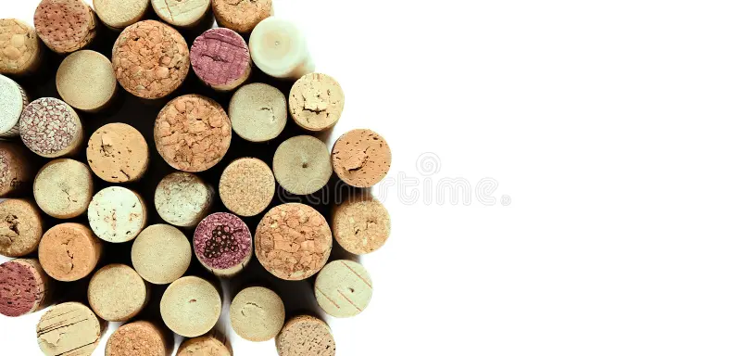
visualization
METRIC | MEASUREMENT | TARGET | ACTUAL
Audience attendance | # of attendees | 150 | 120
Engagement duration | Minutes | 60 | 75
Q&A interaction | # of questions | 10 | 15
Positive feedback | Percentage (%) | 90 | 95
Rate of information retention | Percentage (%) | 80 | 85

Slide 11

visualization
METRIC | MEASUREMENT | TARGET
Audience attendance | # of attendees | 150
Engagement duration | Minutes | 60
Q&A interaction | # of questions | 10
Positive feedback | Percentage (%) | 90
Rate of information retention | Percentage (%) | 80

Slide 12
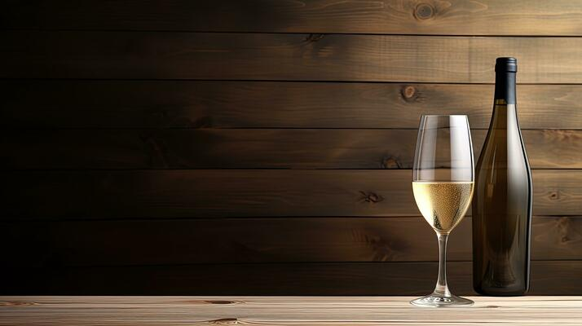
visualization

Slide 13
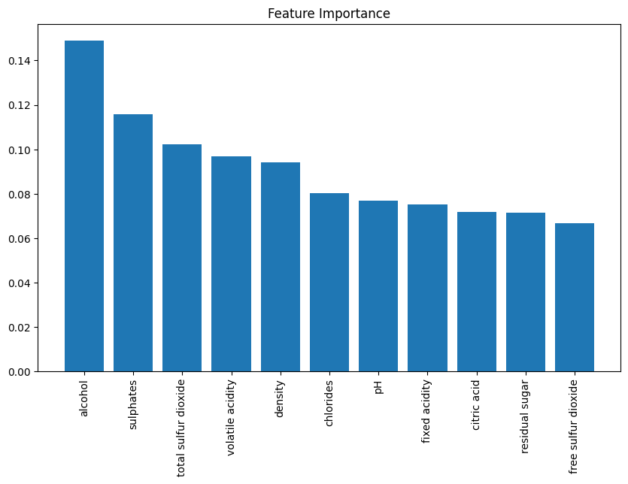
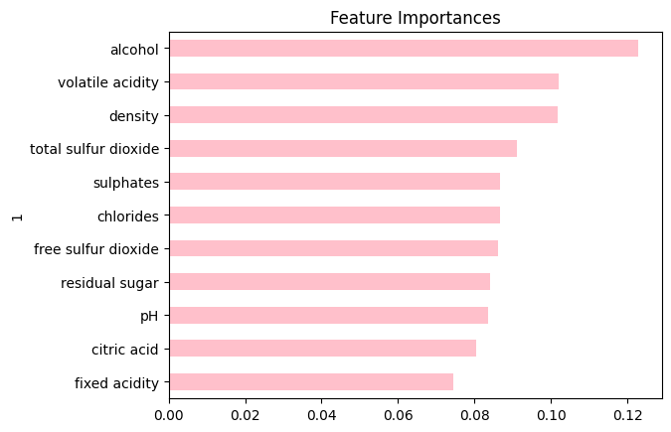
Feature importance

Slide 14
Random forest model
Why we chose this model and results

Slide 15
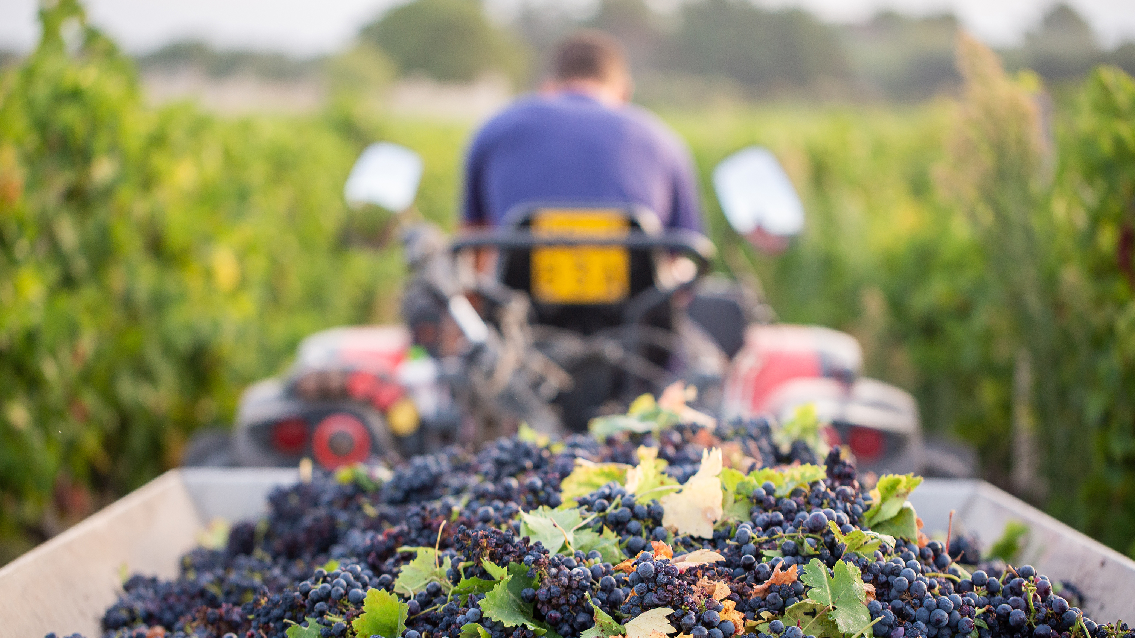
results
Model | Accuracy |  | Loss
White Wine | 0.9976 | 99.8% | 0.0155 | 1.6%
Red Wine | 0.7500 | 75% | 0.6183 | 61.8%
Combined | 0.9415 | 94.2% | 0.1556 | 15.6%

Slide 16
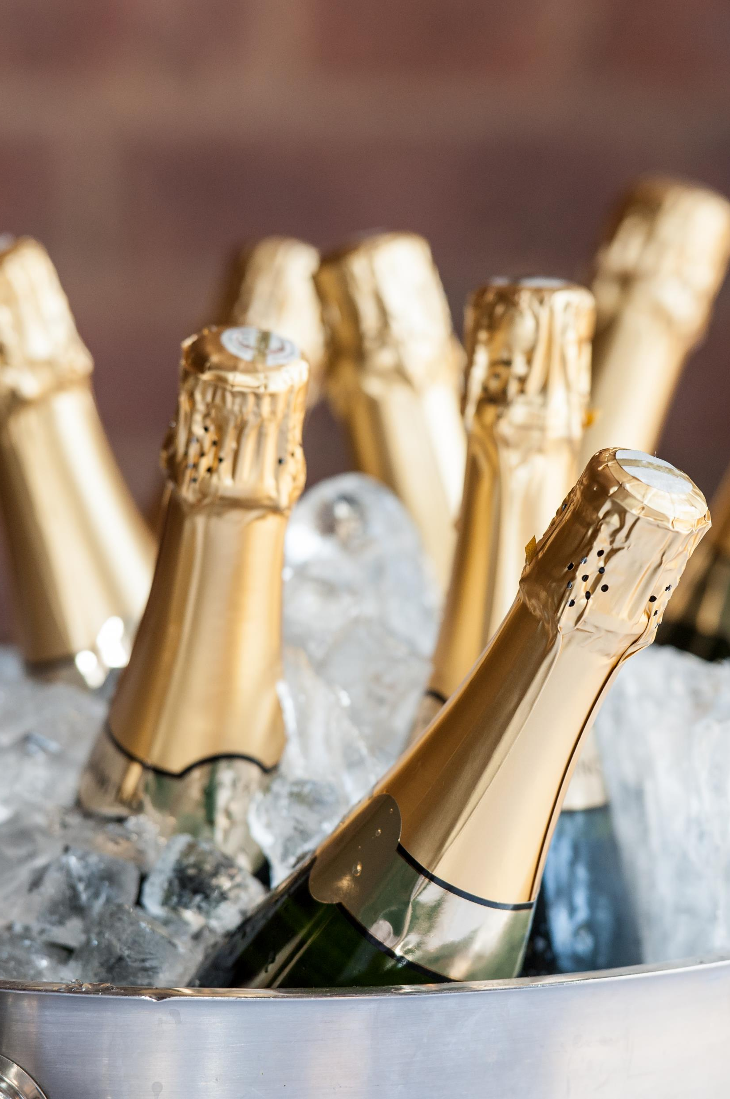
summary

Slide 17
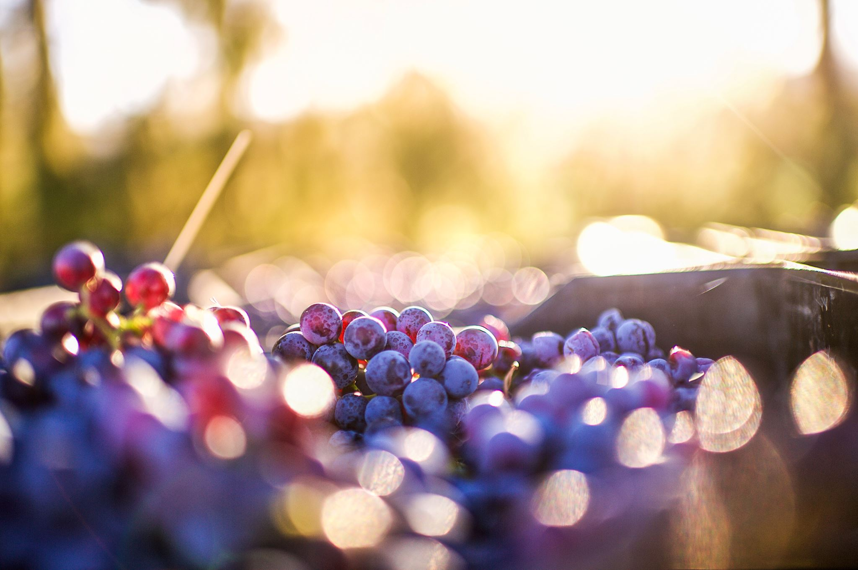
References
Cortez, Paulo, et al. “Modeling Wine Preferences by Data Mining from Physicochemical Properties.” _Decision Support Systems_, vol. 47, no. 4, Nov. 2009, pp. 547–553, https://doi.org/10.1016/j.dss.2009.05.016.
Diehm, Jan, and Lars Verspohl. “Wine & Math: A Model Pairing.” _The Pudding_, 2021, pudding.cool/2021/03/wine-model/. Accessed 5 Sept. 2024.
Parrish, Michael. “What Are Wine Varietals? Comprehensive Guide to Grape Varieties | the Tasting Alliance | the Tasting Alliance.” _The Tasting Alliance_, 14 Mar. 2024, thetastingalliance.com/what-are-wine-varietals-comprehensive-guide-to-grape-varieties/. Accessed 5 Sept. 2024.
Schull, Trista. “How Wine Is Made,” _Witches Falls Winery_, 7 Sept. 2022, witchesfalls.com.au/blogs/news/how-wine-is-made. Accessed 6 Sept. 2024.
The Wine Wankers. “A Great Collection of Wine Infographics,” _The Wine Wankers_, 12 Feb. 2014, winewankers.com/2014/02/12/a-great-collection-of-wine-infographics/. Accessed 5 Sept. 2024.
Theethat Anuraksoontorn. “Wine Quality Prediction with Python - Analytics Vidhya - Medium.” _Medium_, Analytics Vidhya, 21 Sept. 2020, medium.com/analytics-vidhya/wine-quality-prediction-with-python-695939d34d87. Accessed 5 Sept. 2024.
Wine Paths. “The Ultimate Beginners Guide to Wine.” _Www.winepaths.com_, www.winepaths.com/articles/editorial/wine-guide/the-ultimate-beginners-guide-to-wine. Accessed 5 Sept. 2024.

Slide 18
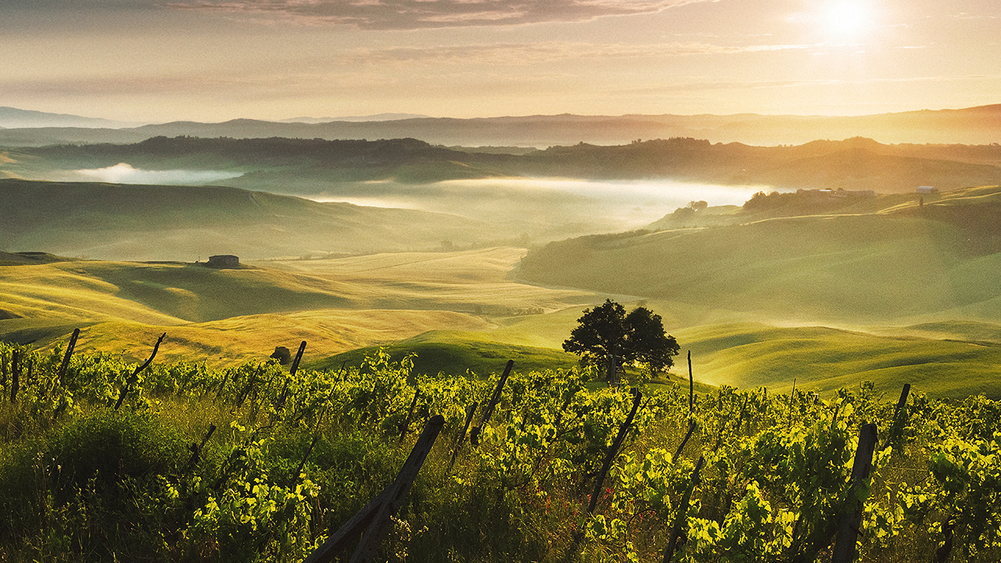
Thank you!

